Slide 1
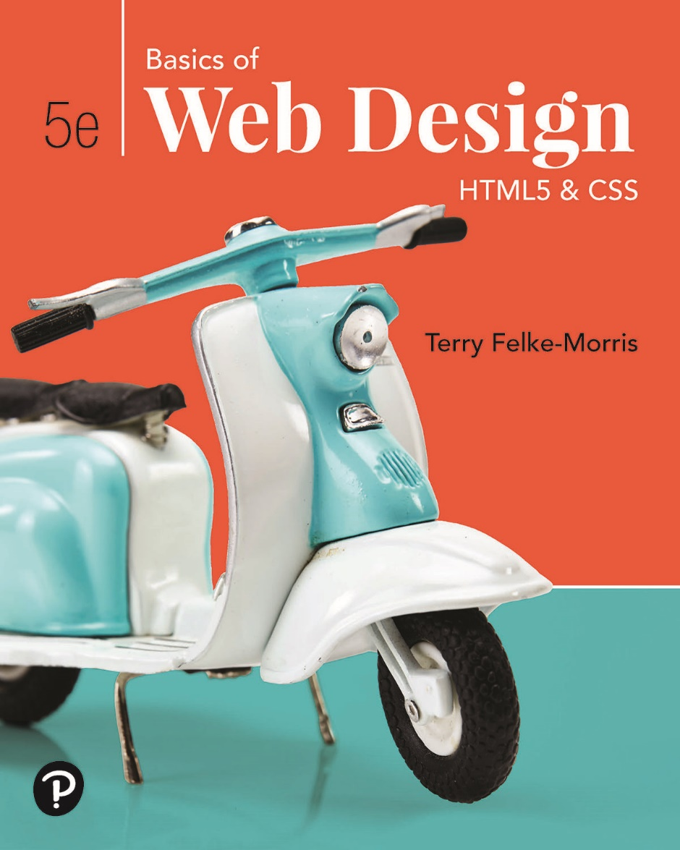
Basics of Web Design
Fifth Edition
Chapter 9
Table Basics Key Concepts
Copyright © 2019 Pearson Education, Inc. All Rights Reserved
Notes:
If this PowerPoint presentation contains mathematical equations, you may need to check that your computer has the following installed:
1) Math Type Plugin
2) Math Player (free versions available)
3) NVDA Reader (free versions available)

Slide 2
Learning Outcomes
Describe the recommended use of a table on a web page
Configure a basic table with the table, table row, table header, and table cell elements.
Configure table sections with the thead, tbody, and tfoot elements.
Configure a table to provide for accessibility
Use C S S to style an H T M L table
Describe the purpose of C S S 3 structural pseudo-classes

Slide 3
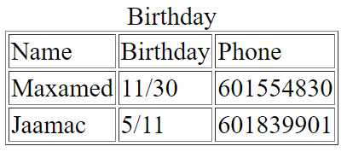
H T M L Table
Tables are used on web pages to organize tabular information
Composed of rows and columns – similar to a spreadsheet.
Each individual table cell is at the intersection of a specific row and column.
Configured with table, tr, and td elements

Slide 4
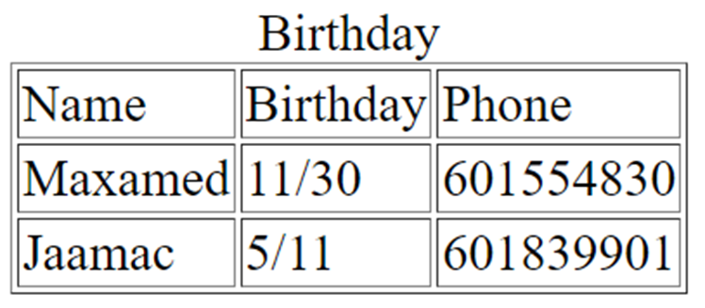
H T M L Table Elements
<table>
Contains the table
<tr>
Contains a table row
<th>
Contains a table header
<td>
Contains a table cell
<caption>
Configures a description of the table

Slide 5
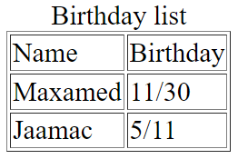
H T M L Table Example 1
<table border="1">
<caption>Birthday list</caption>
<tr>
<td>Name</td>
<td>Birthday</td>
</tr>
<tr>
<td>Maxamed</td>
<td>11/30</td>
</tr>
<tr>
<td>Jaamac</td>
<td>5/11</td>
</tr>
</table>

Slide 6
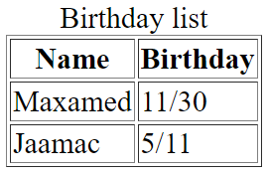
H T M L Table Example 2
<table border="1">
<caption>Birthday list</caption>
<tr>
<th>Name</th>
<th>Birthday</th>
</tr>
<tr>
<td>Maxamed</td>
<td>11/30</td>
</tr>
<tr>
<td>Jaamac</td>
<td>5/11</td>
</tr>
</table>
Using the <th> Element

Slide 7
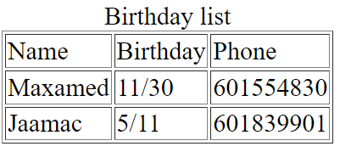
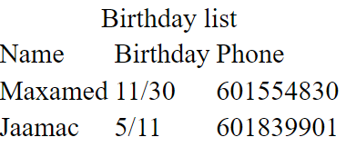
H T M L border Attribute
Indicates the table is specifically used for page layout
Optional
border="1"
Visible browser default border
border= "0"
No visible browser default border

Slide 8
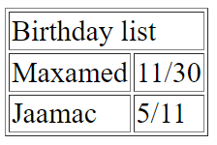
H T M L colspan Attribute
Specifies the number of columns that a cell will occupy.
<table border="1">
<tr>
<td colspan="2">Birthday list</td>
</tr>
<tr>
<td>Maxamed</td>
<td>11/30</td>
</tr>
<tr>
<td>Jaamac</td>
<td>5/11</td>
</tr>
</table>

Slide 9
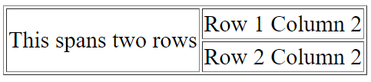
H T M L rowspan Attribute
Specifies the number of rows that a cell will occupy.
<table border="1"> <tr> <td rowspan="2">This spans two rows</td> <td>Row 1 Column 2</td> </tr> <tr> <td>Row 2 Column 2</td> </tr> </table>

Slide 10
Accessibility and Tables
Use table header elements (<th> tags) to indicate column or row headings.
Use the summary attribute on the table element to provide an overview of the purpose and organization of the table.
Use the caption element to provide the title/caption for the table.
Other attributes that provide for accessibility:
headers (in <td>) & id (in <th>)
Scope (in <th> specifies the association of table cells and table row or column headers.

Slide 11
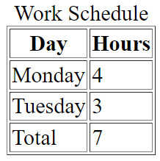
Accessibility: headers & id Attributes
<table>
<caption> Work Schedule</caption>
<tr>
<th id="day">Day</th>
<th id="hours">Hours</th>
</tr>
<tr>
<td headers="day">Monday</td>
<td headers="hours">4</td>
</tr>
<tr>
<td headers="day">Tuesday</td>
<td headers="hours">3</td>
</tr>
<tr>
<td headers="day">Total</td>
<td headers="hours">7</td>
</tr>
</table>

Slide 12
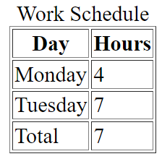
Accessibility: scope Attributes
<table border="1">
<caption>Work Schedule</caption>
<tr>
<th scope="col">Day</th>
<th scope="col">Hours</th>
</tr>
<tr>
<td>Monday</td>
<td>4</td>
</tr>
<tr>
<td>Tuesday</td>
<td>7</td>
</tr>
<tr>
<td>Total</td>
<td>7</td>
</tr>
</table>

Slide 13
Using C S S to Style a Table
H T M L Attribute | C S S Property
align | Align a table: table { width: 75%; margin: auto; } Align within a table cell: text-align
bgcolor | background-color
cellpadding | padding
cellspacing | border-spacing or border-collapse
height | height
valign | vertical-align
width | width
border | border, border-style, or border-spacing
--- | background-image
--- | caption-side

Slide 14
C S S 3 Structural Pseudo-classes
Pseudo-class | Purpose
:first-of-type | Applies to the first element of the specified type.
:first-child | Applies to the first child of an element. (C S S 2 selector)
:last-of-type | Applies to the last element of the specified type.
:last-child | Applies to the last child of an element
:nth-of-type(n) | Applies to the “nth” element of the specified type. Values: a number, odd, or even

Slide 15
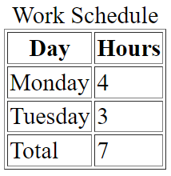
Table Row Groups
<table border="1">
<caption>Work Schedule</caption>
<thead>
<tr>
<th>Day</th>
<th>Hours</th>
</tr>
</thead>
<tbody>
<tr>
<td>Monday</td>
<td>4</td>
</tr>
<tr>
<td>Tuesday</td>
<td>3</td>
</tr>
</tbody>
<tfoot>
<tr>
<td>Total</td>
<td>7</td>
</tr>
</tfoot>
</table>
<thead>
table head rows
<tbody>
table body rows
<tfoot>
table footer rows

Slide 16
Summary
This chapter introduced coding techniques to create and configure tables.
You will find these skills useful as you create web pages.

Slide 17

Copyright
This work is protected by United States copyright laws and is provided solely for the use of instructors in teaching their courses and assessing student learning. Dissemination or sale of any part of this work (including on the World Wide Web) will destroy the integrity of the work and is not permitted. The work and materials from it should never be made available to students except by instructors using the accompanying text in their classes. All recipients of this work are expected to abide by these restrictions and to honor the intended pedagogical purposes and the needs of other instructors who rely on these materials.

